Slide 1


Java se
(Core java)
Lecture-35

Slide 2
Today’s Agenda
• Using JLabel
Property Opaque
Using JTextField
Methods Of JTextField
JOptionPane
Controls for making choices

Slide 3
Using JLabel
The “Jlabel” Class:
The JLabel component in swing is used to display text to the user. This text is read only that is the user cannot change it at run time.
Properties of “JLabel” class:
text: For setting the text on JLabel.
icon: For setting image on JLabel.
font: For changing font of the JLabel.
foreground: For changing the font color of JLabel.
opaque: For making the JLabel opaque so that background color gets applied.
background: For changing the background color of JLabel.
verticalTextPosition
horizontalTextPosition
These properties help us align the text on JLabel with respect to its image.

Slide 4
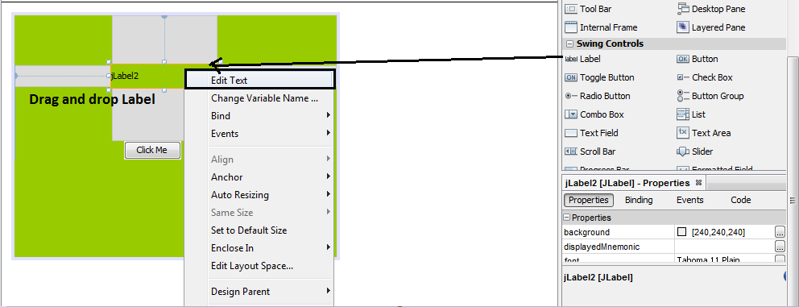
Property Opaque
Property Opaque:
In the Palette, select the Label component and drag it to the Jframe.

Slide 5
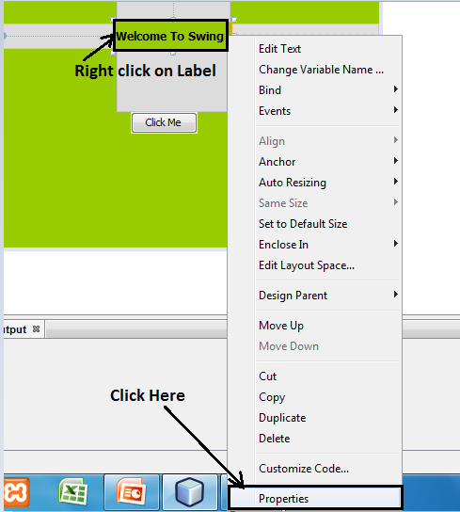
Property Opaque
2. Then select the JLabel make a right click and go to the Properties window on the bottom right corner.

Slide 6
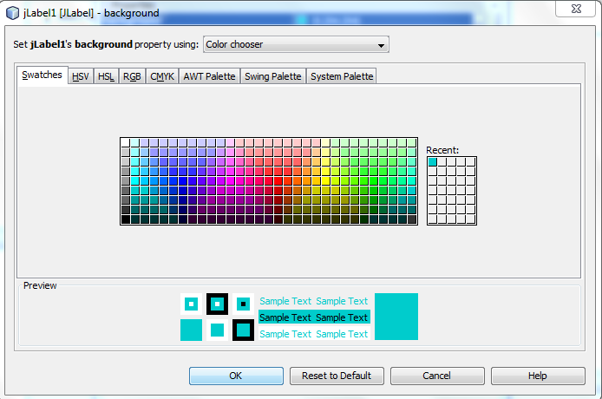
Property Opaque
3. There you will see Background property then choose the desired color. But you will notice that the background color of JLabel doesn't change.

Slide 7
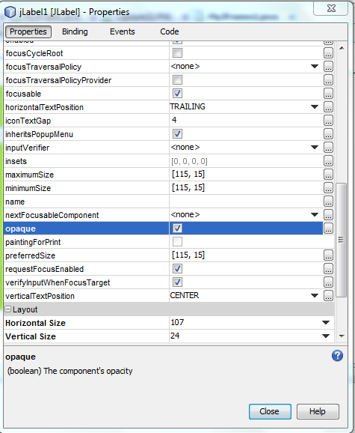
Property Opaque
4. Now keeping the JLabel selected, go to the properties window scroll down and see for the opaque property and then check the checkbox. Now you will be able to see the change in the background color of JLabel.

Slide 8
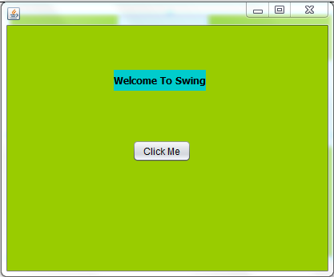
Property Opaque
5. Here is the output:
Methods of “JLabel” class:
1. public Icon getIcon()
2. public void setIcon(Icon)
3. public void setText(String)
4.public String getText()

Slide 9
JTextField
The “JTextField” class:
In GUI TextFields or TextBoxes are components used for taking input from the user. They are rectangular components displayed on our Frame or Panel and allow the user to input/type some text. In swing , java povides us a class called JTextField for this.
Properties of JTextField:
text: For setting the text on JTextField.
editable: For making JTextField editable/uneditable.
font: For changing font of JTextField.
foreground: For changing the font color of JTextField.
background: For changing the background color of JTextField.

Slide 10
Methods of JTextField
Methods of JTextField
Methods of JTextField:
1.public String getText( )
2.public void setText(String)
3.public void setEditable(boolean)
4. public void setFont(Font)

Slide 11
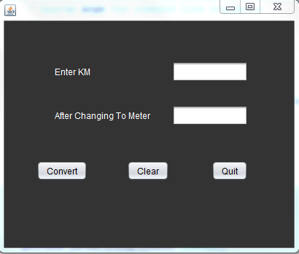
Example
Develop a swing based GUI application which accepts km from user and provides three button with the following behavior:
1. Convert: This button should convert km into m and display the result in second TextField.
2. Clear: Should erase contents of the all Textfields and bring focus to the first one.
3. Quit: Should terminate the application.

Slide 12
Example
private void jButton3ActionPerformed(java.awt.event.ActionEvent evt) {
System.exit(0); // For Quit Button
}
private void jButton2ActionPerformed(java.awt.event.ActionEvent evt) {
txtKm.setText("");
txtMeter.setText(""); // For Clear Button
txtKm.requestFocus();
}
private void jButton1ActionPerformed(java.awt.event.ActionEvent evt) {
String km=txtKm.getText();
int kmnum=Integer.parseInt(km);
int mtr=kmnum*1000; // For Convert Button
txtMeter.setText(String.valueOf(mtr));
}

Slide 13
JOptionPane
The "JOptionPane" class:
1. Message Dialog
2. Confirm Dialog
3. Input Dialog
Generating "MessageDialog" :
1. public static void showMessageDialog(Component,Object)
2. public static void showMessageDialog(Component,Object,String,int)
3. public static void showMessageDialog(Component,Object,String,int,Icon)

Slide 14
JOptionPane
The "int" argument represents the predefined icons we want to use on Dialog Box and java has provided following options for this:
1. JOptionPane.ERROR_MESSAGE
2. JOptionPane.QUESTION_MESSAGE
3. JOptionPane.INFORMATION_MESSAGE
4. JOptionPane.PLAIN_MESSAGE
The Code:
JOptionPane.showMessageDialog(null,"Please input digits only!","Error!",JOptionPane.ERROR_MESSAGE);

Slide 15
Modified version of Convert Button Code
private void jButton1ActionPerformed(java.awt.event.ActionEvent evt)
{
String km=txtKm.getText();
try
{
int kmnum=Integer.parseInt(km);
int mtr=kmnum*1000;
txtMeter.setText(String.valueOf(mtr));
}
catch(NumberFormatException e)
{
JOptionPane.showMessageDialog(null,"Please input digits only!","Error Occurred",JOptionPane.ERROR_MESSAGE);
}
}

Slide 16
Using Confirm Dialog
Confirm Dialog is mainly used for users choice before taking a particular action. To generate a confirm dialog java provides us a method called showConfirmDialog() having three overloaded versions:
Generating "ConfirmDialog" :
1. public static int showConfirmDialog(Component,Object)
2. public static int showConfirmDialog(Component,Object,String,int)
3. public static int showConfirmDialog(Component,Object,String,int,int);
4. public static int showConfirmDialog(Component,Object,String,int,int,Icon);

Slide 17
Using Confirm Dialog
The first "int" argument represents the predefined buttons we want to use on Dialog Box and java has provided following options for this:
1. JOptionPane.YES_NO_OPTION
2. JOptionPane.OK_CANCEL_OPTION
3. JOptionPane.YES_NO_CANCEL_OPTION
4. JOptionPane.DEFAULT_OPTION
The return value "int" represents the button user has pressed and it's values are:
1.JOptionPane.YES_OPTION
2.JOptionPane.NO_OPTION
3.JOptionPane.OK_OPTION
4.JOptionPane.CANCEL_OPTION

Slide 18
The Modified Code For “Quit” Button
private void jButton3ActionPerformed(java.awt.event.ActionEvent evt) {
int ans;
ans=JOptionPane.showConfirmDialog(null,"Are u sure?","Quitting!",JOptionPane.YES_NO_OPTION,JOptionPane.QUESTION_MESSAGE);
if(ans==JOptionPane.YES_OPTION)
System.exit(0);
}

Slide 19
Using Input Dialog
Input dialogs are used in those cases where we want to accept some input also from the user at runtime. To generate an input dialog java provides us a method called showInputDialog belonging to the class JOptionPane. This method has same argument as message dialog but its return type is string.
Generating "InputDialog" :
1. public static String showInputDialog(Object)
2. public static String showInputDialog(Component,Object)
3. public static String showInputDialog(Component,Object,String,int,Icon)

Slide 20
The Modified Code For “Quit” Button
private void jButton3ActionPerformed(java.awt.event.ActionEvent evt) {
int ans;
ans=JOptionPane.showConfirmDialog(null,"Are u sure?","Quitting!",JOptionPane.YES_NO_OPTION,JOptionPane.QUESTION_MESSAGE);
if(ans==JOptionPane.YES_OPTION)
{
String name=JOptionPane.showInputDialog(null,"What is your Name?");
JOptionPane.showConfirmDialog(null,"Thank You " +name+ " for using this app");
System.exit(0);
}
}

Slide 21
Controls For Making Choices
In a GUI Application it is very common for a programmer to ask the user to provide his choice amongs an available list of choices.
For ex. :-We might want to offer the user choice of selecting his gender or hobbies and in such cases rather than using a text field java advices us to use choice control. There are 4 choice control given by java calles as:
JCheckBox
JRadioButton
JComboBox
Jlist

Slide 22
JCheckbox
Checkboxes are toggle buttons and are mainly use to allow the user to select more than one option amongs the available list of choices. Following are important properties of a JCheckbox:
text: For setting the text on checkbox.
icon: For setting image on checkbox.
selected: A boolean property for deciding the initial state of checkbox.
font: For changing font of the checkbox.
background: For changing the background color of checkbox.
foreground: For changing the font color of checkbox.

Slide 23
Handling JCheckBox Event
Events Fired In JCheckBox:
Whenever the user selects or de-selects a JCheckBox object , Java executes the "ItemEvent" and calls the method
"itemStateChanged( )" which is available in the interface "ItemListener".
Obtaining State Of a JCheckBox:
To determine whether a JCheckBox object is currently selected or not we call the method isSelected( ) of "JCheckBox" class. The prototype of the method is:
public boolean isSelected( )

Slide 24
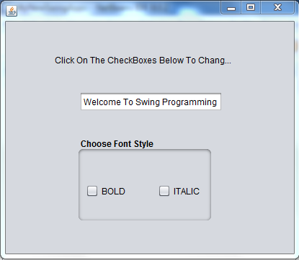
Example
Develop an application containing a text field and two checkboxes titled Bold and Italic. As the user selects or deselects these checkboxes apply the required effect on the text in text field.

Slide 25
Example
private void chkBoldItemStateChanged(java.awt.event.ItemEvent evt) {
changeStyle();
}
private void chkItalicItemStateChanged(java.awt.event.ItemEvent evt) {
changeStyle();
}
private void changeStyle() {
int fontstyle= Font.PLAIN;
if(chkBold.isSelected())
fontstyle+=Font.BOLD;
if(chkItalic.isSelected())
fontstyle+=Font.ITALIC;
Font f=new Font("Tahoma",fontstyle,11);
jTextField1.setFont(f);
}

Slide 26

End Of Lecture 35
For any queries mail us @: scalive4u@gmail.com
Call us @ : 0755-4271659, 7879165533
Agenda for Next Lecture:
1. Using JRadioButton.
2. JComboBox Component

